Slide 1
Unit -2
Creative thinking

Slide 2
Contents
Types of creative thinking
Creative idea process
Components of creativity
Characteristics of a creative mindset
New product ideas
Idea generation methods
Principles of idea generation
Difference between idea generation and brainstorming
Killing the ideas through stage gate models
Process of reverse thinking
Intellectual property rights
Importance of IPR
Role of WIPO
Case Studies on Patents and Infringement of Rights.
s

Slide 3
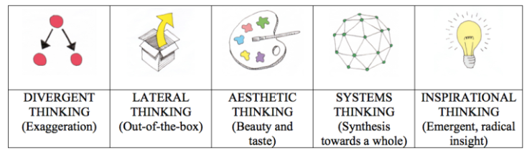
Types Of Creative Thinking

Slide 4
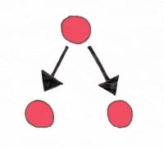
DIVERGENT THINKING
“The work of art is the exaggeration of the idea”
Divergent thinking is the process of thought where a person uses flexibility, fluency and originality to explore as many solutions or options to a problem or issue as possible. It is the opposite of convergent thinking, which has the characteristic to focus on only one idea or single solution.
Examples:
A medical student doesn’t always have to be either a doctor or nothing. She could very well make a career switch in the future and be a writer, or a painter, and varieties of other possibilities.

Slide 5

LATERAL THINKING
“Creativity involves breaking out of established patterns in order to look at things in a different way”
Lateral thinking can be used for generation of new ideas and problem solving as it by definition leaves the already-used behind and looks for completely new options.
lateral thinking tools and techniques can be used to restructure and escape such “clichéd” patterns and think “outside the box”.

Slide 6
Lateral thinking is related to divergent thinking. Both have the purpose to break out of habitual ways of thinking. Both falls “outside the box”.
Example
If you’ve been involved with a student society that was struggling financially, a logical solution to the problem might be to seek to cut costs.
If you use lateral thinking, however, you might come up with a great new fundraising idea, devise a novel initiative to boost membership, or approach a contact you’ve made through some other means to secure sponsorship.

Slide 7

AESTHETIC THINKING
“It took me four years to paint like Raphael, but a lifetime to paint like a child”
This type of thinking involves producing or discovering things, which are pleasant, harmonious and beautiful to our senses. It is an ancient form of thinking within us humans, and can be learned by anyone.
Some of the types of aesthetic thinking are visual and spatial, where knowledge of structure, composition, color schemes and shapes can be used to make things aesthetically pleasing.
Example
Many architects, designers, painters, Music, drama and other forms of culture

Slide 8

SYSTEMS THINKING
“Creativity is just connecting things. When you ask creative people how they did something, they feel a little guilty because they didn’t really do it, they just saw something. It seemed obvious to them after a while”.
There are a number of different principles for a system thinking, some of which are interdependence of objects, holism (emergent properties not possible to detect by analysis but possible to define by a holistic approach) and hierarchy (complex wholes are made up of smaller subsystems).
A foundational aspect of systems thinking is the synthesis of several elements into one, which transcends the significance of the sum of the two independent elements.

Slide 9

INSPIRATIONAL THINKING
This type of creative thinking concerns the perception of receiving insights from somewhere or someone else. It often happens in dreams or other states, but sometimes in extremely powerful, rapid bursts of clarity and focus, known as light-bulb moments or peak experiences.
Example
“I was living in a little flat at the top of a house and I had a piano by my bed. I woke up one morning with a tune in my head and I thought, ‘Hey, I don’t know this tune – or do I?’ It was like a jazz melody. My dad used to know a lot of old jazz tunes; I thought maybe I’d just remembered it from the past. I went to the piano and found the chords to it, made sure I remembered it and then hawked it round to all my friends, asking what it was: ‘Do you know this? It’s a good little tune, but I couldn’t have written it because I dreamt it”- Paul McCartney

Slide 10
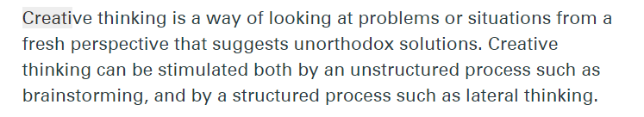
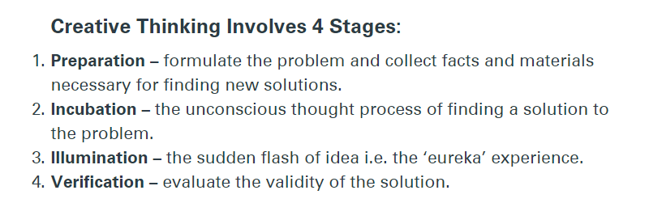
Creative Thinking Process

Slide 11
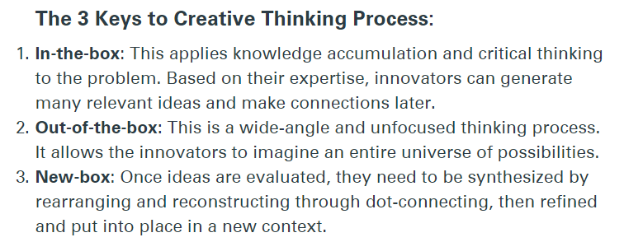
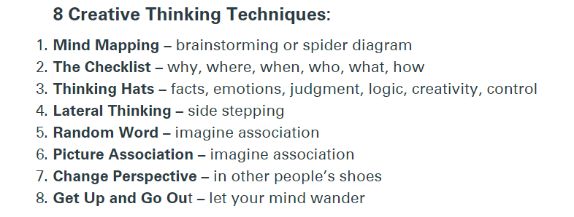

Slide 12

Components of Creativity
Creativity is learned through practice. While young children are inherently creative, the development of long-term creative potential depends on experience.
The “7 Components of Creativity” provides a framework of the key processes or skills that contribute to creativity, organized across three childhood developmental areas: cognitive; social and emotional; and physical.

Slide 13
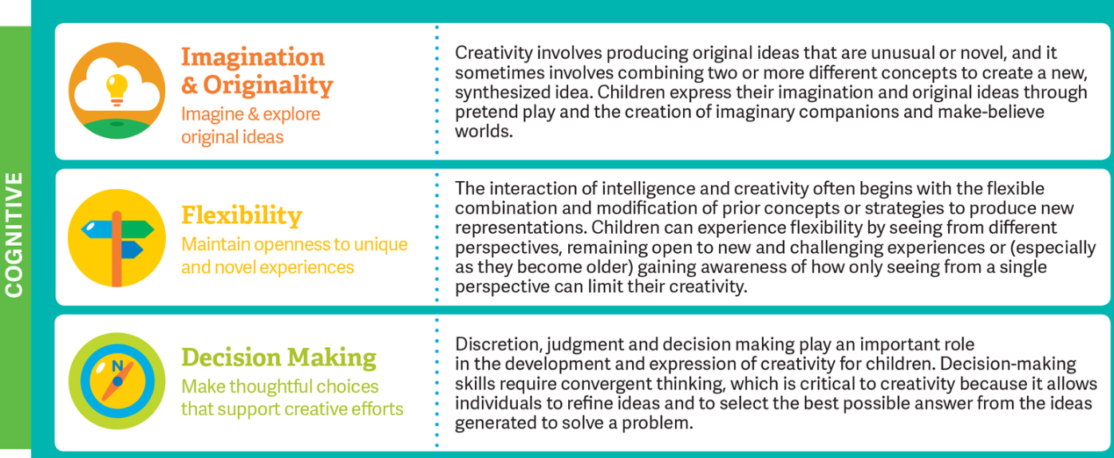

Slide 14
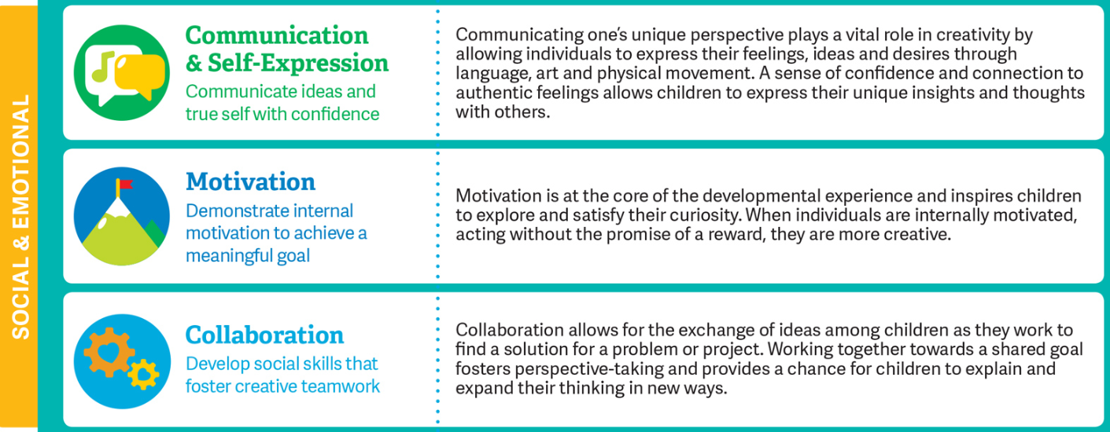

Slide 15
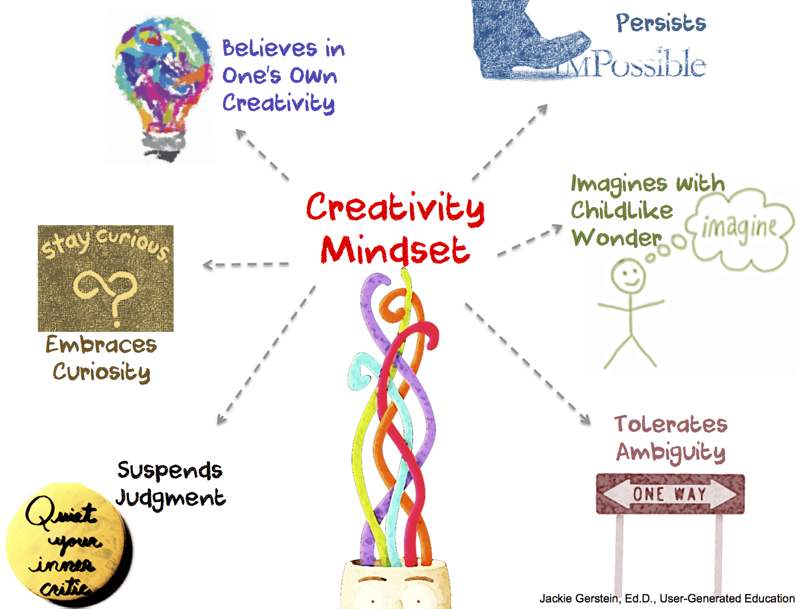
Characteristics of a Creative Mindset
Having the outlook, attitude and beliefs that empower and support you to be as creative as you can.
The Characteristics of the Creativity Mindset include:
Believes in One’s Own Creativity
Embraces Curiosity
Suspends Judgment – Silences the Inner Critic
Tolerates Ambiguity
Persists Even When Confronted with Skepticism & Rejection
Taps Into Childlike Imagination; a Child’s Sense of Wonder

Slide 16

Believes in One’s Own Creativity
Central to a creativity mindset is the belief that one is and can be creative.
It becomes self-statements that revolve around, “I can be creative.”
You have to believe that your creativity has meaning.
You have to believe with all your heart that if you don’t express your creativity that you are not living up to your full potential, will never experience true happiness, or find the ultimate meaning of your existence.

Slide 17

Embraces Curiosity
Creative people want to know things–all kinds of things– just to know them.
Knowledge does not require a reason. The question, “Why do you want to know that?” seems strange to the creative person, who is likely to respond, “Because I don’t know the answer.” Knowledge is enjoyable and often useful in strange and unexpected ways.
Suspends Judgment – Silences the Inner Critic
The ability to hold off on judging or critiquing an idea is important in the process of creativity.
Often great ideas start as crazy ones – if critique is applied too early the idea will be killed and never developed into something useful and useable.

Slide 18

Tolerates Ambiguity
Ambiguity tolerance may be… the “willingness to accept a state of affairs capable of alternate interpretations, or of alternate outcomes.”
With the toleration of ambiguity, creativity gives way to new ideas, stimulates the acceptance of others’ viewpoints, and thus raises tolerance, understanding and cooperation.
Persists Even When Confronted with Skepticism & Rejection
Creative people who actually see their ideas come to fruition have the ability to stick with their ideas and see them through – even when the going gets tough.
This is what sets apart the great from the good in this whole sphere. Stick-ability is key.

Slide 19
Taps Into Childlike Imagination; a Child’s Sense of Wonder
When children play, they often do so in very original ways.
However, with the responsibilities of adulthood, this playful curiosity is sometimes lost and conventional responses often result.
Individuals imagining themselves as children subsequently produced more original responses.

Slide 20
New Product Ideas
Generating and screening ideas for new products
Successful new product development (NPD) starts with identifying good product ideas and using reliable criteria to decide which ideas to pursue.
Idea generation
Write a customer needs list based on the information you gather from the sources identified below. You should try to identify existing weaknesses in your products, gaps in your product range and areas for product improvement.

Slide 21
Use your research and development (R&D) processes
Use your business's existing R&D processes. Identify modifications you could make to existing products, or adaptations for new products, consistent with feedback from your market and customers.
Review your quality assurance (QA) processes
Note any issues in your products and identify potential ideas for addressing gaps in quality.

Slide 22
Review your customer complaint records
Identify common weaknesses in our existing product range, and look for areas where improvement is most needed.
Review your research
Review our customer research and market research, and plan further market and customer surveys if you identify research gaps.
What are our customers telling us they're looking for?
What do they find frustrating or limiting about our products? How do they use our products most?

Slide 23

Talk to your suppliers and other business partners
Talk to manufacturers, retailers and sales reps to capture their knowledge of our products and thoughts for improving them.
Research and understand your competition
Try to understand our competition. Review our competitors' product range and consider how the market is responding to them. Do any of their products seem to be meeting needs that ours aren't?
Study catalogues and product information
Make sure we have a comprehensive understanding of existing products available in the market.

Slide 24
Idea Screening
With our list of potential new product ideas, you now need to decide which ideas to pursue and which to discard.
Consider your competition, your existing products, their shortcomings, and the needs of your market.
Draw on the customer needs list you have developed, and the areas for product improvement you have identified.
Develop a set of criteria to evaluate your ideas against. Your criteria might include:
Most prominently identified customer needs.
Product improvements most needed the benefits to our target market the technical feasibility of the idea.

Slide 25
The level and scope of research and development required
The profitability of the idea. What is its potential appeal to the market? How would you price it? What are the costs in bringing it to market - overall and per unit?
Where the product fits in the market. Is there a gap? How close is it to competitor products?
The resources it will require in development
The marketing potential of the idea
The fit with your business profile and business objectives.
SWOT analysis (build on strengths (S), minimize weakness (W), seize opportunities (O), counteract threats (T) can help you to identify the strengths and weaknesses of each idea.

Slide 26
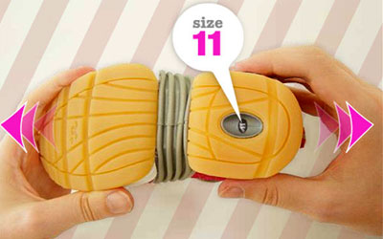
Idea Generation Methods
Steps for Idea Generation
New ideas from around the world
Ingredients for a good idea
How to come up with a business idea – watching trends

Slide 27
Ingredients For A Good Idea
For sustainability
Qualified Plan
Economics
It must make a profit
Demand
People must want it

Slide 28
How to come up with a business idea – watching trends
There are thousands of ideas out there
Look for needs, watch trends, listen for complaints, problems or pains…. Then get creative about building a business around them
Low Cost
Wellbeing
Environment
Convenience
Grey Power

Slide 29
Principles Of Idea Generation
Ideation must be driven by strategy that has 4 steps:
Example:
Specifically, a company should use its strategic plan to identify areas of interest for future products.
These areas of interest can be identified by “voice of the customer” research.
The company then uses this information to establish clear objectives. Objectives should have boundaries and be specific, Boundaries help focus the ideation process so that it leads to ideas that are more executable.
Objectives take into account both an internal perspective (the company’s core competencies, for example) and external factors (the market, the competition, etc.).

Slide 30
Step 1: Once a company has an objective, it can create an idea campaign, challenge or event around that objective.
An idea campaign is a specialized, short-duration business process in which a company seeks to generate ideas focused on a specific market area, problem, product line, technology, or business strategy.
By following this structure, each idea campaign is linked to the company’s strategic plan through the objective.

Slide 31
Step 2:
Connect idea submitters to other knowledge sources to facilitate discovery. That is, potential submitters (who may number in the thousands) connect to a community of knowledgeable people who nurture the idea into something that can be reviewed effectively.
Step 3:
Companies must have a culture that encourages ideation. Cultures that encourage ideation have three pillars: collaboration, contribution and public recognition

Slide 32
Step 4:
Companies need a process by which to flow ideas consistently and efficiently through the work process.
The process begins with a relevant, large set of related ideas that are developed and combined to increase their attractiveness.

Slide 33
Stage Gate Process
The State Gate process is a patented trademark of Dr Robert Cooper.
The model focuses on the innovation process and is also referred to as the waterfall process.
It is a project management technique, in which an initiative or project takes place, divided over several stages.
These stages are separated by so-called ‘gates’; the decision points for whether or not to proceed to the next stage.
This model can be used when developing new products, process changes or improvements.

Slide 34
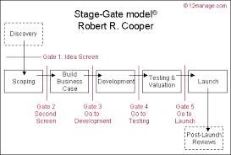
Stage Gate Process

Slide 35
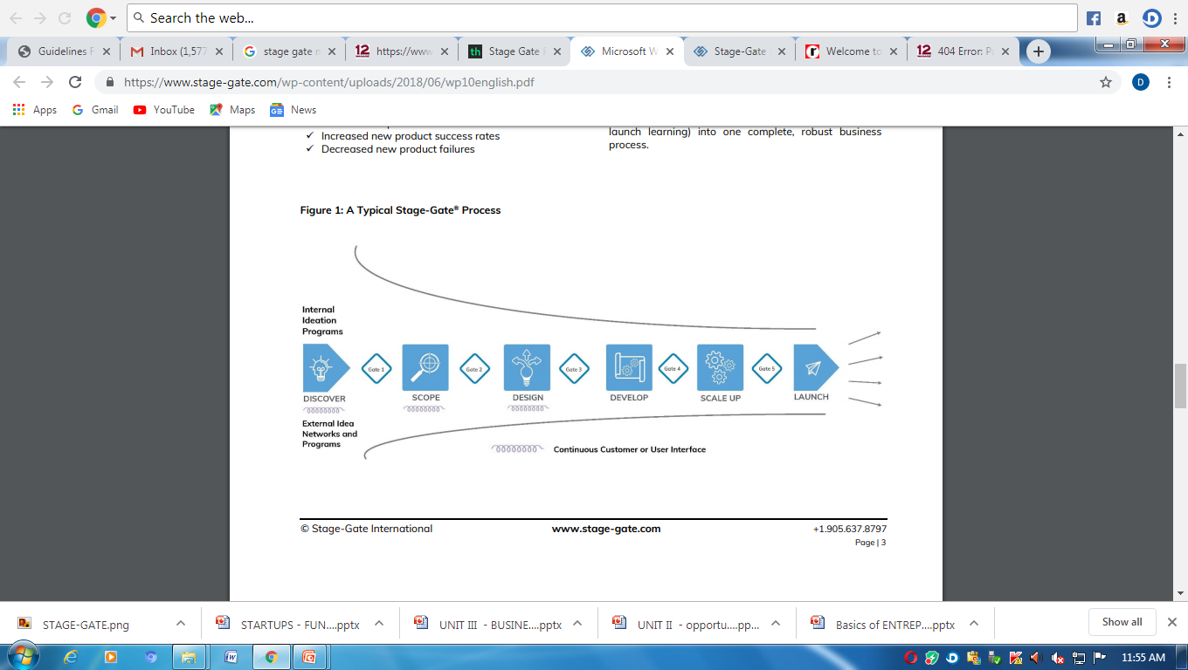
Stage Gate Process

Slide 36
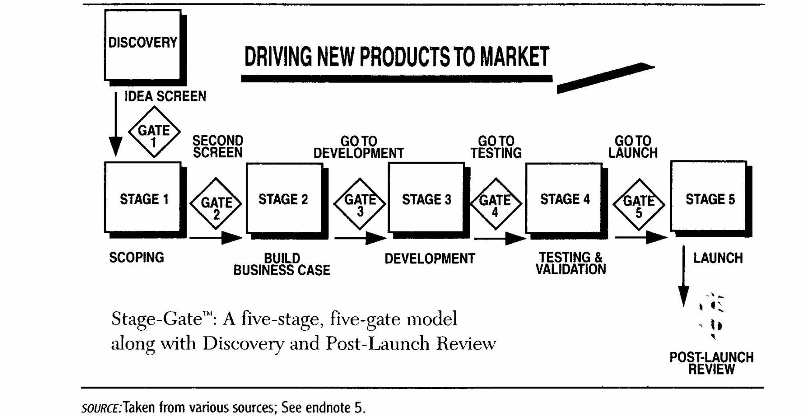
Stage Gate Model

Slide 37
Stage Gate Process
Gates
At each gate, a decision is made whether to continue the process or not.
This decision is based on the prognosis and information available at that moment and The quality of an idea is assessed at each of the gates.
This concerns the quality of the execution, business motivation to continue financially and the action plan showing what needs to be done in order for the project to have a chance at succeeding.

Slide 38
Stage Gate Process
Gates
At each gate, a decision is made whether to continue the process or not.
This decision is based on the prognosis and information available at that moment and The quality of an idea is assessed at each of the gates.
This concerns the quality of the execution, business motivation to continue financially and the action plan showing what needs to be done in order for the project to have a chance at succeeding.

Slide 39
Stage Gate Process
Gates – Decisions
Go: The project is good enough to move on to the next stage.
Kill: The project is not good enough to develop further and is shut down right away.
Hold: The project is neither good enough nor bad enough. It is put on hold to possibly be resumed at a later date.
Recycle: The project is good enough to develop further, provided some changes are made.

Slide 40
Stages
The Stage Gate process consists of a number of stages, which are connected to each other by gates. Each stage is designed to collect specific information:
Stage 0: discovery
Stage 1: scoping
Stage 2: business plan concept
Stage 3: development
Stage 4: testing and validation
Stage 5: launch and implementation

Slide 41
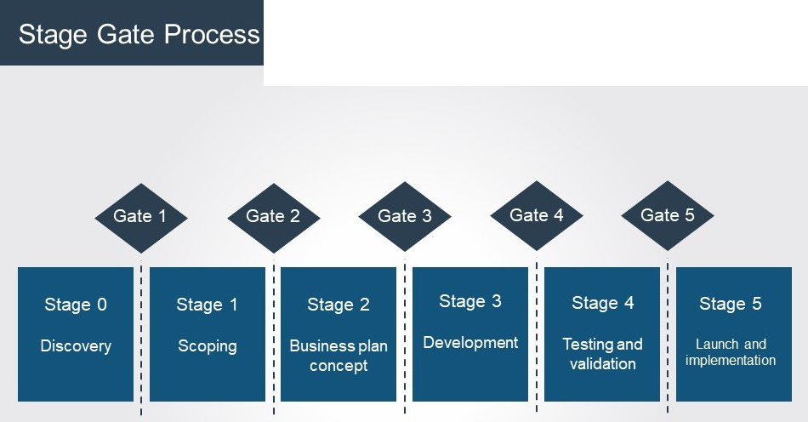

Slide 42
Stage 0: discovery
This initial preparatory stage determines which project a company wants and is able to carry out.
Ideas can be generated in brainstorming sessions. Employees, Customers and suppliers provide useful information.
An idea is first selected and then proposed. If the idea is not worth the effort, the gate closes here.
Stage 1: Scoping
This stage is all about evaluating the product and the associated market.
What are the product’s strengths and weaknesses and what can it bring to the user/consumer in terms of added value? This stage takes all the possible threats from competitors into account.
Based on the assessed threat, production will or will not continue.
The greater the threat, the greater the chance that the gate will close.

Slide 43
Stage 2: Business plan concept
Now that the product is resistant to competition, a business plan is drawn up.
This is the last stage of concept development and is crucial before the starting with development of the actual product.
This stage is very labor-intensive and includes sub-stages that need to be completed:
Product definition and analysis
The customer value is determined by finding out which benefits the product offers and what conditions and functions it must meet.
Creating the business plan
In this document the product is described and defined, including the legal health and safety requirements.

Slide 44
Creating the project plan
This plan contains a list of all tasks that are planned during the entire development process, and the people who will carry them out.
The expected launch date can also be found in this plan.
Feasibility review
This includes a feasibility study in which different departments assess the plan’s chances of succeeding.
If, after this stage, it appears that the business concept does not have sufficient potential to generate turnover, the gate will close.

Slide 45
Stage 3: Development
During this stage, the plans from the previous steps are carried out and simple tests are conducted. For example, at this stage customers can be asked what they think of the product.
The development team also creates a timeline with specific milestones that have to be achieved.
This timeline can be revised and updated regularly.
It also incorporates multi-functional teamwork; different departments provide input with expert advice.
This ultimately results in a product prototype, which will be extensively tested during the next stage. The gate will remain closed if the product has not been sufficiently developed.

Slide 46
Stage 4: Testing and validation
This stage covers product testing and validation.
They also look at the manufacturing process and how the product is accepted by customers and the market.
This also means that a number of sub-stages are completed during this stage:
Near testing
The purpose of this test is to identify possible production errors or other issues.
It is no longer a prototype; the product is almost ready to be sold.
Field testing
In this part, the product is tested in the field by various participants who can make a valuable contribution.
This is usually done with the help of customers.
It is important to find out whether this target group is interested in the product, which characteristics they consider important and in which context the product will be used.

Slide 47
Market testing
This test is optional. After a period, the product is assessed to see whether it sufficiently matches the needs and wishes of the consumer.
If not, the gate to the next stage will remain closed.
Stage 5: Launch and implementation
The marketing strategy comes into play. The product is ready to be launched, which will include advertising campaign, free publicity (press releases) and interviews.
The sales team is predominantly responsible for ensuring a smooth process.

Slide 48
Reverse Thinking
Reverse thinking (also known as Reverse Brainstorming) forces a small team that's been focused on a problem for a long time to think about it completely differently - and come up with a broad range of new ideas that might help to solve it.
Rephrase the question so as to create problems, instead of solutions.
EXAMPLE: How can we get more subscribers to our newsletter?
REPHRASED: How can we get people to unsubscribe to our newsletter?
Instead of asking, "How do I solve or prevent this problem?" ask, "How could I possibly cause the problem?"

Slide 49
Reverse Thinking - Steps
Clearly identify the problem or challenge, and write it down.
Reverse the problem or challenge by asking, "How could I possibly cause the problem?" or "How could I possibly achieve the opposite effect?"
Brainstorm the reverse problem to generate reverse solution ideas. Allow the brainstorm ideas to flow freely. Do not reject anything at this stage.
Once you have brainstormed all the ideas to solve the reverse problem, now reverse these into solution ideas for the original problem or challenge.
Evaluate these solution ideas. Can you see a potential solution? Can you see attributes of a potential solution?
Instead of asking, "How do I solve or prevent this problem?" ask, "How could I possibly cause the problem?"

Slide 50

INTELLECTUAL PROPERTY RIGHT
Intellectual property (IP) refers to creations of the mind: inventions, literary and artistic works, and symbols, names, images, and designs used in commerce.
These rights can include copyrights, patents, trademarks, and trade secrets. These rights may be enforced by a court via a lawsuit.
The reasoning for intellectual property is to encourage innovation without the fear that a competitor will steal the idea and / or take the credit for it.

Slide 51

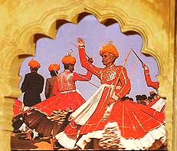



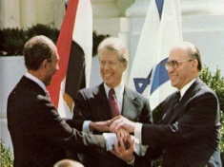
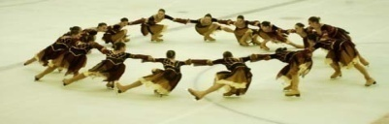
INTELLECTUAL PROPERTY RIGHT
Trademark & domain names
Copyright
Trade secrets
Patent
Categories of IP rights
Utility model/Designs
Geographical Indications
Plant Breeder’s rights

Slide 52
Classification of IPR
IPR
Intellectual Property
Patents
Broadcasting
Music
Trademarks
Dramatics Works
Copyright
Literature
Industrial Design
Sound Recording
Works of Art
Geographical
Indications
Computer Programs

Slide 53
Need for Protection of IP
To provide an incentive to disclose to the public for further creations
To give such creators official recognition;
To create repositories of vital information;
To prevent others from illegally exploiting the creation
To avoid re-inventing the wheel

Slide 54
Three Statutory Pillars of Patentability
Three Statutory Pillars of Patentability are:
Novelty (new): Must be New, Must Distinguish from “State of the Art” (PRIOR ART)
Inventive Step (non-obvious): The differences between the claimed invention and the prior art are such that the subject matter as a whole would not have been obvious at the time the invention was made to a person skilled in the art, to which the subject matter pertains.
Industrial Applicability (utility): Be Useful; Must work /be workable ;At least one recognized, verifiable and practical end-use

Slide 55
Intellectual property
INDUSTRIAL PROPERTY
+
COPY RIGHT
PATENTS
DESIGNS
TRADEMARKS
Geographical
Indications
Industrial property useful for industries and in commerce
Copyright granted to the authors of novels, poems, plays, films, musical works, artistic works such as drawings, paintings, photographs, sculptures, and architectural designs.

Slide 56




Trademarks
Word Mark
Device Marks
(Signs, Symbols, Logos)
Collective Marks
Certification Marks
Service Marks

Slide 57
Trademarks - Characteristics
Must be graphically represented
Must be distinctive / distinguishable
Must not be descriptive
Must not be deceptively similar to known /well-known marks /Generics
To Avoid –
Geographical Indications / Deities National Leaders / Heroes / Symbols / Laudatory words

Slide 58


Copyrights
Copyright is a legal term describing rights given to creators for their literary and artistic works. Copyright extensions include:
Recordings
Broadcastings
Audio visual works
Computer programs
Digital databases
Internet/web

Slide 59


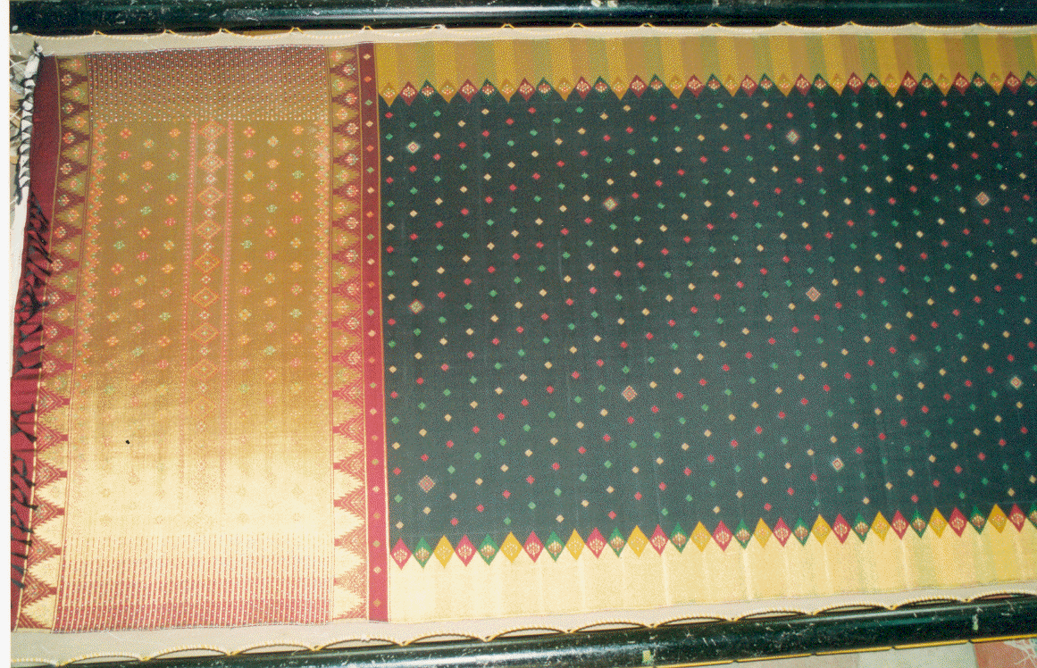



Geographical Indications
Name or sign used on goods originating from specific geographical origin or location and possess qualities, reputation or characteristics that are essentially attributable to that place of origin.

Slide 60
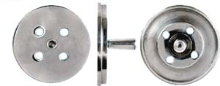
Industrial Designs
Ornamental or Aesthetic aspect of an article.
3-D or 2-D features such as shape or surface, patterns, lines or color.
Industrial designs are applied to products of industry and handicraft, technical and medical instruments, watches, jewelry, house wares, electrical appliances, luxury items, vehicles, architectural structures, textile designs.
Does not protect any technical features of the article to which it is applied to.

Slide 61
IP- Duration of Term of Protection
Patents (20 years)
Trademarks (10 years + renewals)
Copyrights in published literary, dramatic, musical, and artistic works (Lifetime of author +60 years).
Copyright in photographs ,cinematographic film, sound recordings –(60 years from year in which it was published)
Broadcast reproduction right-(25 years from the beginning of the calendar year next following the year in which the broadcast is made.)
Performers right-(25 years from the beginning of the calendar year next following the year in which the performance is made)
Industrial designs (10 years+ renewal permitted once for 5 years )
Trade-secrets and know how collectively “proprietary technology” (contract period-protected by contract provisions, doctrine of breach of trust)

Slide 62
World Intellectual Property Organization (WIPO)
WIPO was established in 1970, following the entry into force of the WIPO Convention in 1967. It has ith a mandate from its Member States to promote the protection of intellectual property throughout the world through cooperation among States and in collaboration with other international organizations.
The Organization became a specialized agency of the United Nations in 1974. The Director General is Francis Gurry.

Slide 63
World Intellectual Property Organization (WIPO)
Based in Geneva, with an international staff of some 1,300 employees, WIPO counts 184 Member States – more than 90 percent of the world’s countries.
WIPO is dedicated to developing a balanced and accessible international intellectual property (IP) system, which rewards
creativity,
stimulates innovation and
contributes to economic development while safeguarding the public interest.

Slide 64
WIPO – Mission Statement
To promote through international cooperation the creation, dissemination, use and protection of works of the human spirit for the economic, cultural and social progress of all mankind.
WIPO’s objectives are to promote intellectual property protection throughout the world through cooperation among states and, where appropriate, in collaboration with any other international organization.

Slide 65
WIPO – Protection of intellectual property
As part of the United Nations system of specialized agencies, WIPO serves as a forum for its Member States to establish and harmonize rules and practices for the protection of intellectual property rights.
WIPO also services global registration systems for trademarks, industrial designs and appellations of origin, and a global filing system for patents.

Slide 66
An agreement on cooperation between WIPO and the WTO came into force on 1 January 1996.
The agreement provides cooperation in three main areas:
notification of, access to and translation of national laws and regulations
implementation of procedures for the protection of national emblems
and technical cooperation.

Slide 67
Case Studies – IP Protection
New Delhi Aug28, 2002. Central Bureau of Investigation (CBI) officials in New Delhi nabbed Shekhar Verma, a former employee of Mumbai-based Geometric Software Solutions Company and a computer engineer from the Indian Institute of Technology, Kharagpur.
It turned out that Verma was accused of stealing $60 million worth of source code of a software product of Geometric Software's US-based client, SolidWorks, and trying to sell them to other companies for a fortune.
The American firm has the exclusive rights over the software.

Slide 68
Calcutta, 7 April 2000:
The Enforcement Branch, Calcutta police with the assistance from Nasscom and BSA, seized pirated software worth of Rs. 2.61 crore (US$ 6,08,000) from companies while conducting raids in the city.
4 persons, including owners, partners and senior level employees of the companies, were arrested for this offence.
The police recovered around 636 CDs, and 2 computers loaded with pirated software.

Slide 69
Hyderabad, March 2000:
Hyderabad Police, with assistance from Nasscom (National Association of Software & Services Companies) and Business Software Alliance (BSA), seized pirated software worth of Rs. 75,16,400 (US$ 174,800) from 7 companies at a conducted raid.
13 people, including senior level employees of the companies, were arrested in this regard.
The Police recovered around 293 CDs, 5 hard disks and 7 computers loaded with pirated software.
The estimated value of the pirated software was worth Rs.77 lakh.

